Slide 1

Analyzing NBA Performance Trends Through a Database-Driven Visualization Framework
Alejandro Cruz
Deepak Paudal
Krutik Soni
Jonathan Walter
Jordan Staley
Alberta School of Business
University of Alberta
Master of Management Analytics
MMA 604 - Database Fundamentals for Business Analytics
Dr. Yonghua Ji
December 4th, 2025

Slide 2

Outline
Introduction
Database Design
Data Source
Data Assembly Process
Logical Model
Data Visualization
Summary

Slide 3
Intro
Why this dataset: Motivated by our team's strong interest in basketball and the sports industry, we want to analyze NBA data to explore how player performance and team behaviour inform the strategic, data-driven decisions franchises make on and off the court.

Slide 4

Questions
Which players have shown the most consistent performance across multiple seasons?
How do rookie players compare to league veterans in key performance metrics?
Can we identify trends in player performance that align with All-Star selections or MVP awards?
Are certain positions associated with higher scoring or assists?
What is the relationship between team performance and player salary?
Which teams have the highest win rates at home versus away games?
Is there a significant relationship between a team's improvement or decline in the standings and the change in its average home attendance next season?

Slide 5

Data Source
NBA API: Players, teams, stats, histories, awards
ESPN Attendance: Season attendance
ESPN Salaries: Annual salary data
ESPN Standings API: Team performance metrics

Slide 6

Database Assembly
Python-based Extract → Transform → Load workflow
Standardized all datasets (names, formats, seasons)
Created consistent team and player ID mappings
Linked all tables using unified keys
Loaded cleaned, connected data into the SQL database

Slide 7
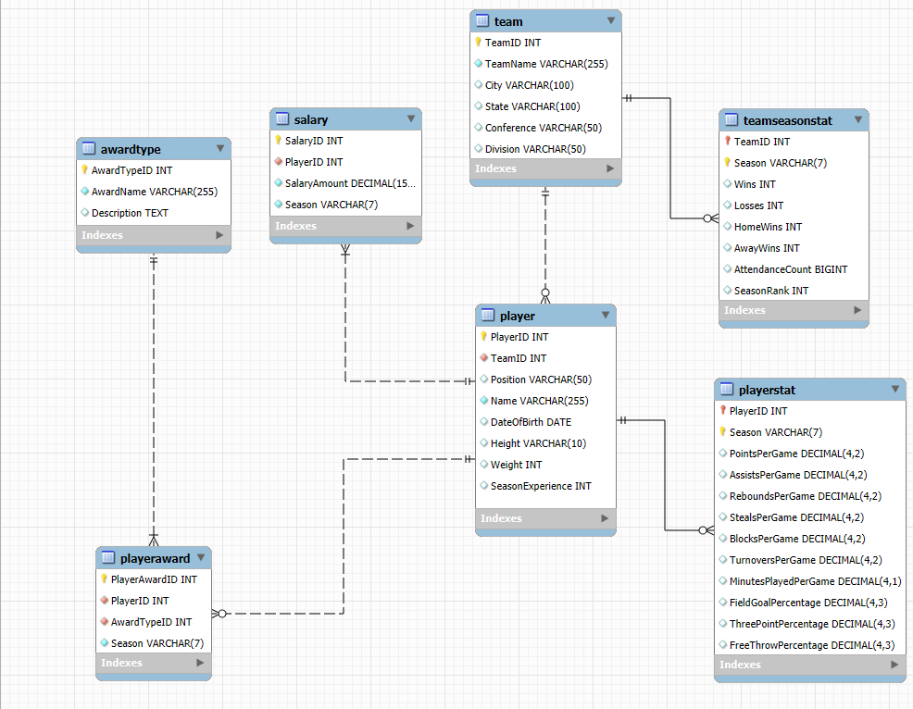
Logical Model

Slide 8
Key Insights from Visualizations

Slide 9
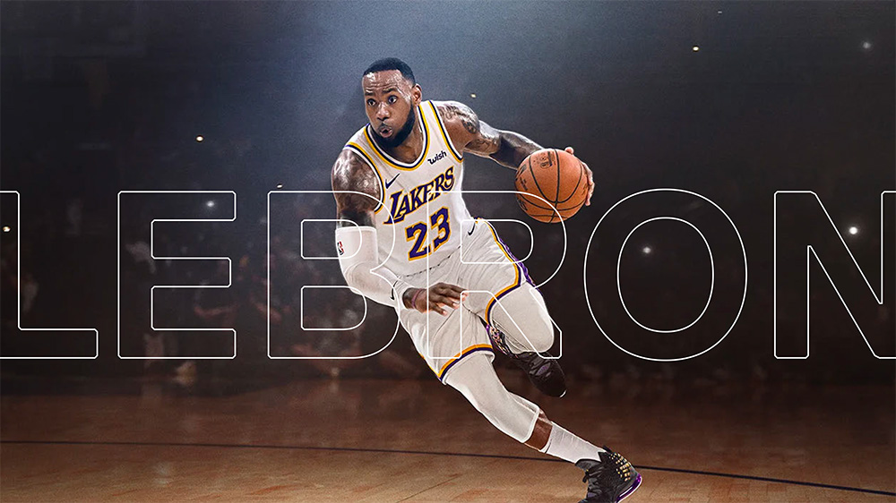
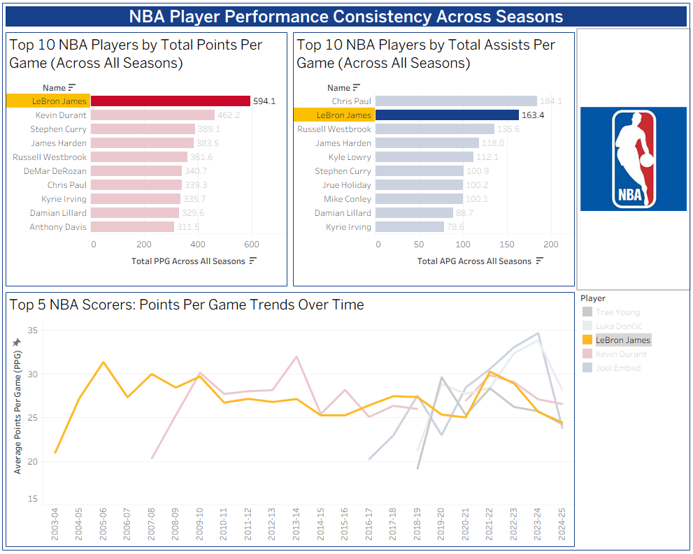
Which players have shown the most consistent performance across multiple seasons?

Slide 10

Consistency Metrics
How do rookie players compare to league veterans in key performance metrics?
Can we identify trends in player performance that align with All-Star selections or MVP awards?
Consistency metrics:
Measure stability in performance season-over-season
Help identify top players
Useful for long-term valuation and team strategy

Slide 11
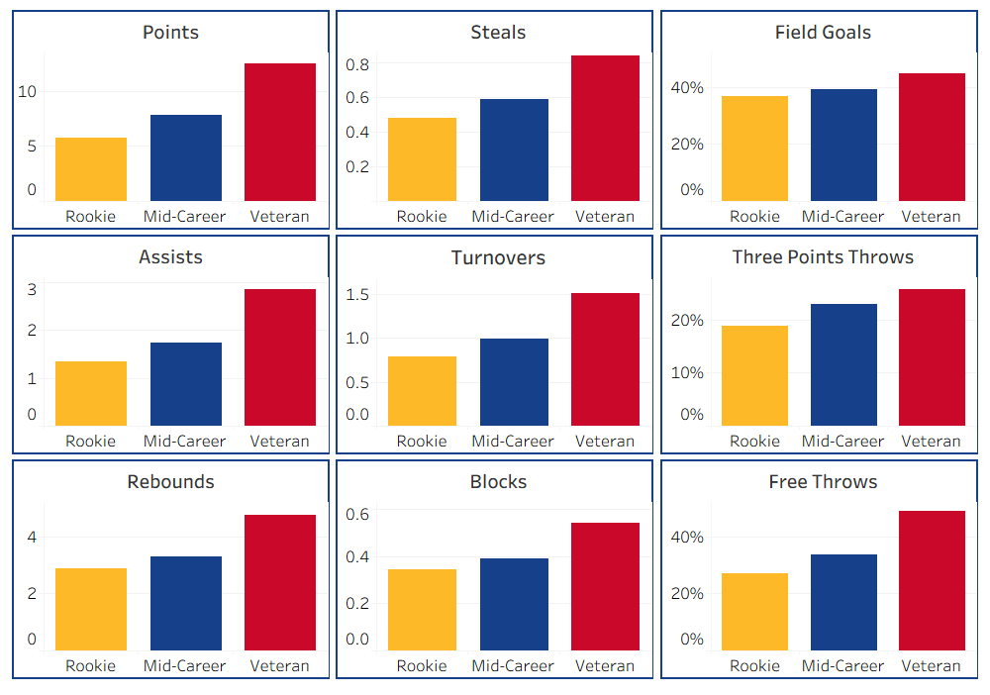
Veterans show much higher performance
Veterans
-> 5+ yrs
Mid-career
-> 2-4 yrs
Rookies
-> 1 yr
Veterans consistently outperform up to 2x
Notes:
Description:
Bar charts comparing average scores for players across groups based on total years of experience for 9 performance metrics
Discussion:
Some metrics show up to 2x performance difference between rookies and veterans
Shows that experience is critical for performance
Suggests securing talent early through long contracts could be efficient per-dollar spent on salaries
Creating:
Used playerstat table to compare player performance metrics to seasons of experience
Calculated field labeling each player as rookie (1yr), mid-career (2-4yrs), veteran (5+ yrs) based on years of experience at time of data collection
Averaged metrics across players

Slide 12
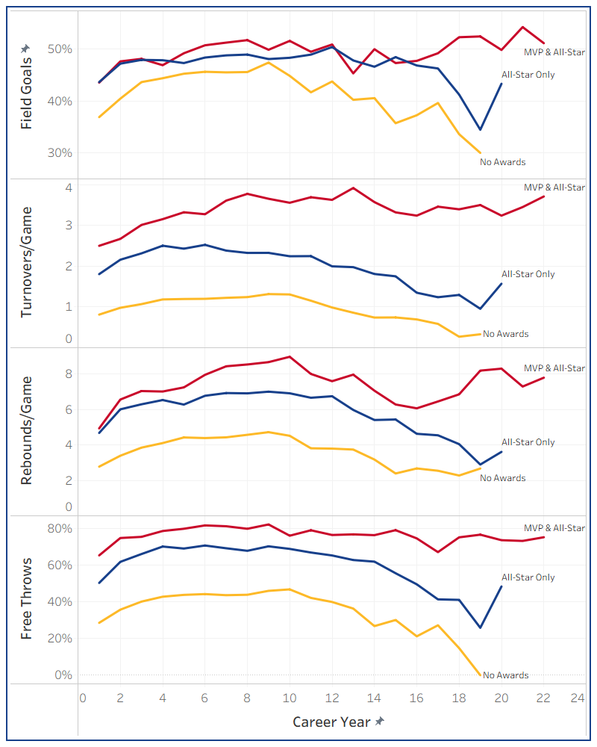
MVPs remain consistent over their career
Players without awards fall off
All stars perform better
MVPs stay strong
Can predict MVP/All-Star in just one season
Turnovers/game is an especially useful metric for early prediction

Slide 13
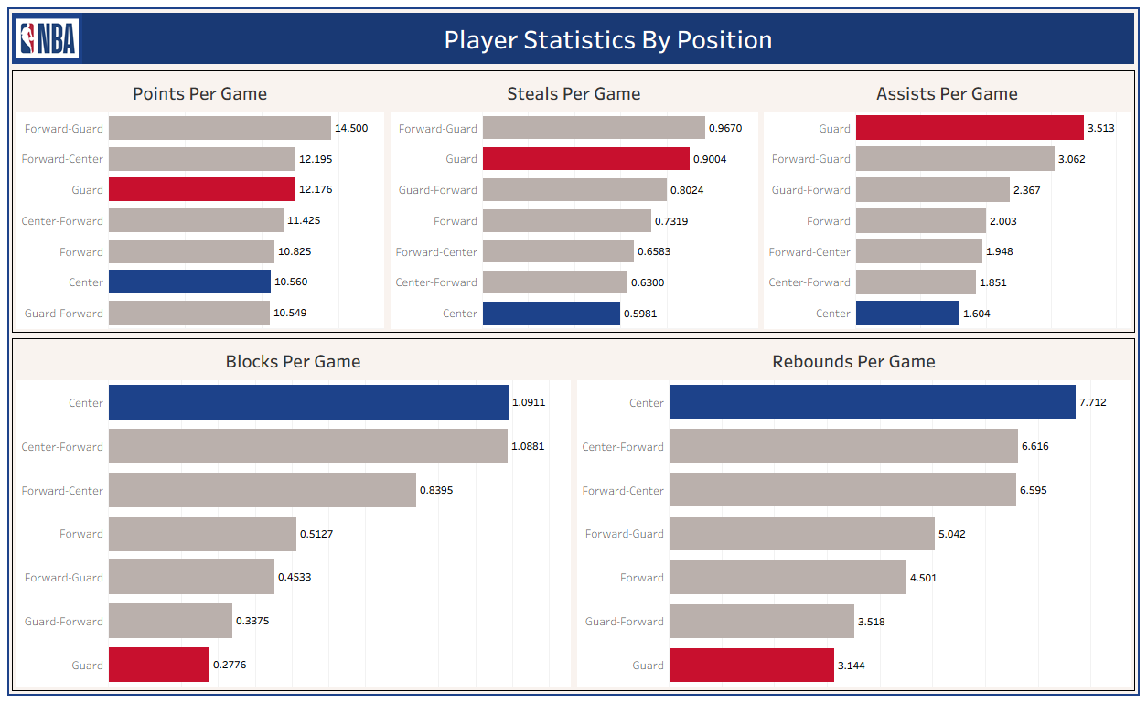
Positions Impact on Stats
Guard positions have higher steals, and assists
Centers have higher rebounds and blocks
Forwards score more but all positions contribute relatively evenly

Slide 14


Slide 15
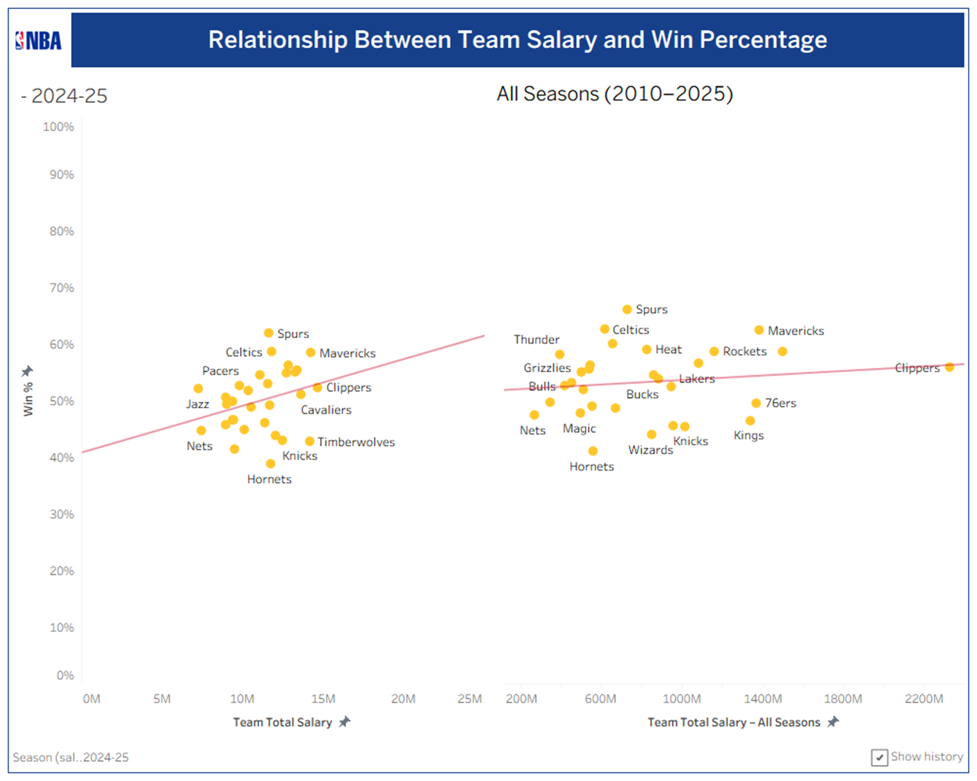
Teams that spend more win more games
More salary generally means more wins. Teams with larger payrolls tend to post higher win percentages.
But the relationship is only moderate. The all-seasons view shows a shallow trend line; money helps, but it’s not a guarantee.
Some high-spending teams underperform. For example, the Clippers have one of the highest total salaries but only slightly above average win %.
Some mid-spending teams overperform. Teams like the Celtics, Nuggets, Heat and Mavericks win as much (or more) than the biggest spenders with less total salary.

Slide 16
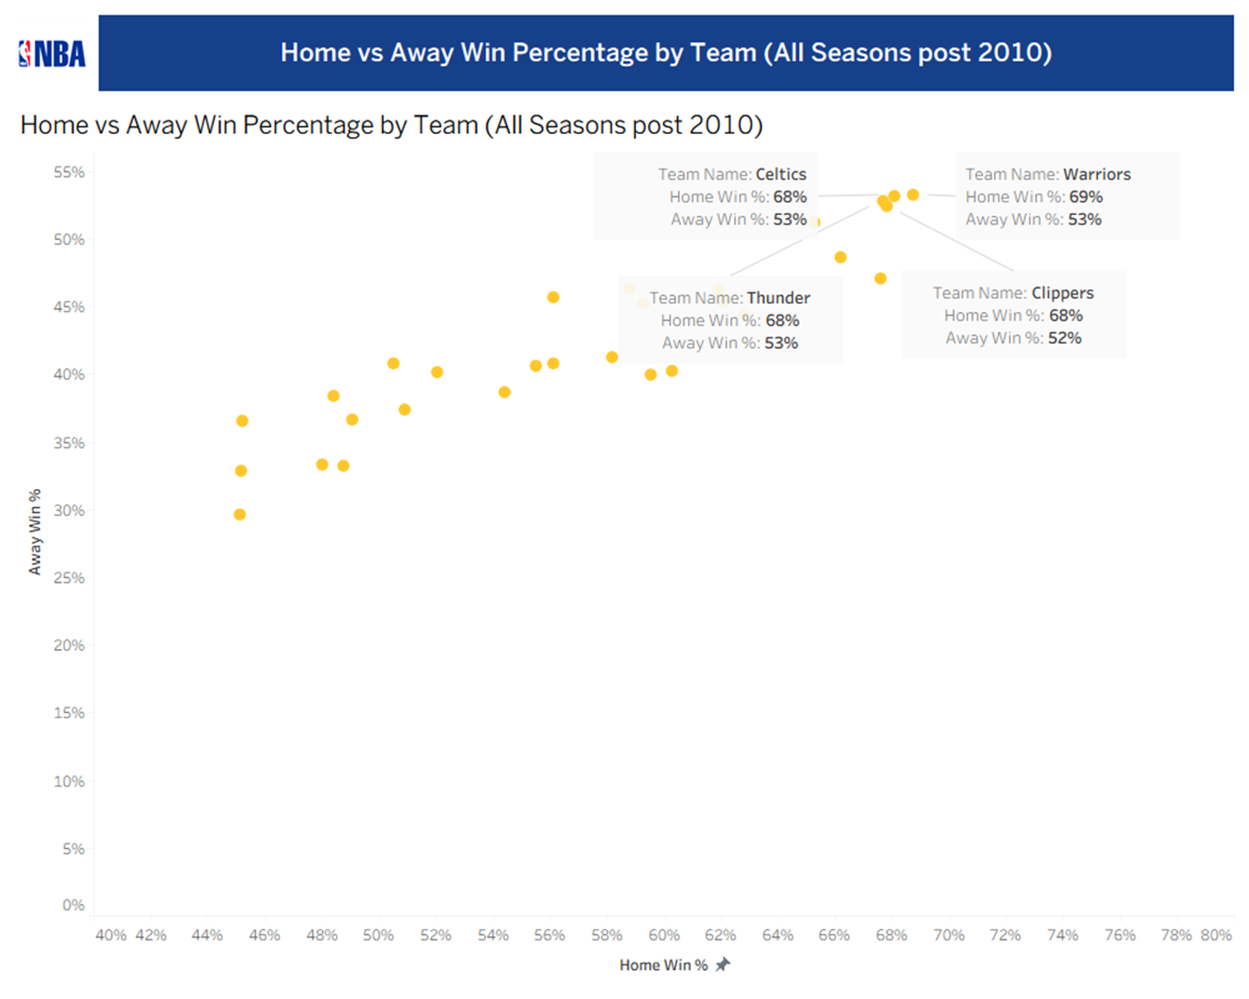
Teams win more at home
Winning travels. Teams that win more at home generally also win more on the road (upward-sloping cloud of points).
Four standout teams. Warriors, Celtics, Thunder and Clippers all win about 68–69% of home games and 52–53% of away games since 2010.
Most teams rely on home court. The rest of the league clusters around the mid-50% range at home and high-30s to low-40s away.
Takeaway: A few teams are consistently strong everywhere, while most are solid at home but noticeably weaker on the road.

Slide 17
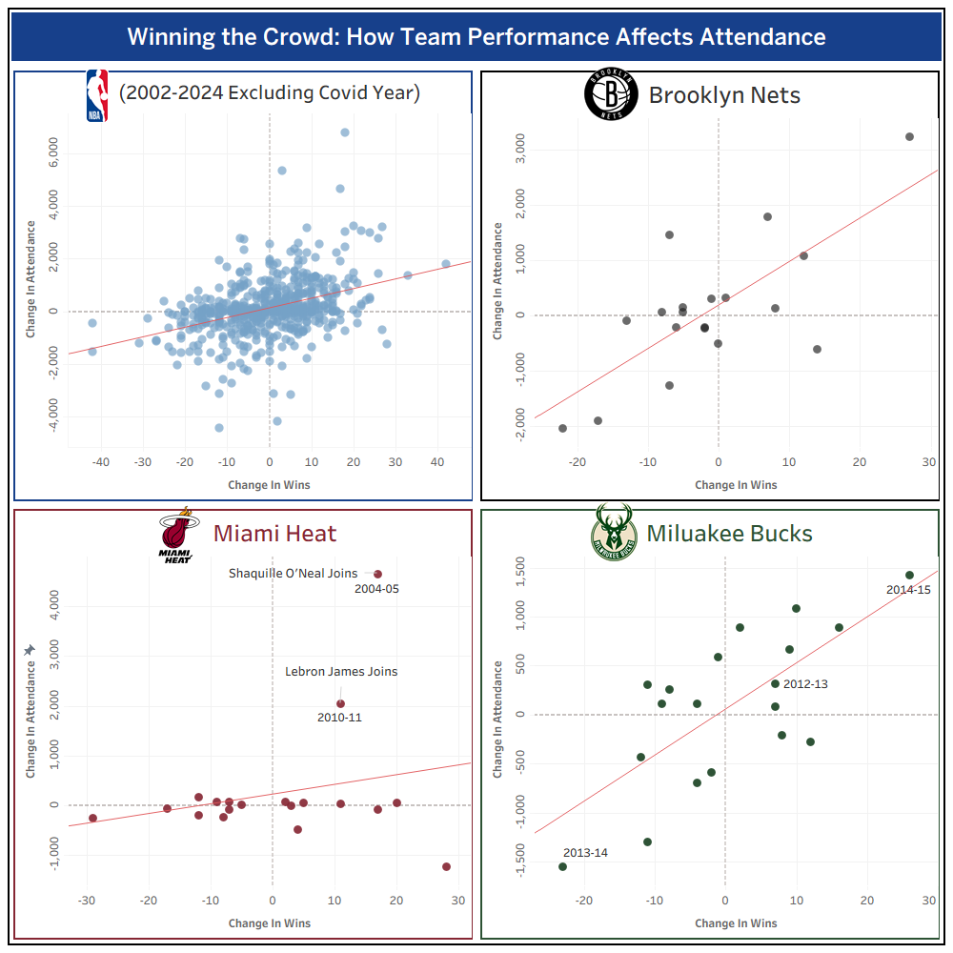

Winning Matters To Fans
More wins means more stadium attendance generally
Stadium attendance for some teams is much more performance based
Some teams have consistent attendance despite poor performance
Star players joining greatly boosts attendance

Slide 18

Summary
Player Value and Long-Term Investment
Salary Spending vs. Performance Efficiency
Home Performance and Fan Engagement
Experience Matters for Performance

Slide 19
References
NBA Basketball Database from Kaggle:
https://www.kaggle.com/datasets/wyattowalsh/basketball/data Includes detailed tables on player stats, salaries, teams, and more.
2001-2026 NBA Attendance - National Basketball Association - ESPN
Find out the 2001-2026 attendance numbers for every NBA team.
https://www.espn.com/nba/attendance/_/year/
Basketball Stats and History Statistics, scores, and history for the NBA, ABA, WNBA, and top European competition.
https://www.basketball-reference.com/

